Slide 1


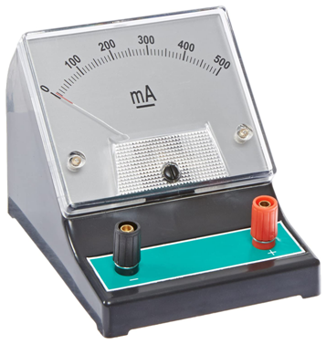

FROM-CHANDANA M N CSE-087
DC AMMETER

Slide 2
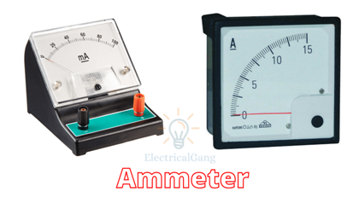
DC AMMETER
Current is the rate of flow of electric charge. If this electric charge flows only in one direction, then the resultant current is called Direct Current (DC). The instrument, which is used to measure the Direct Current called DC ammeter.

Slide 3
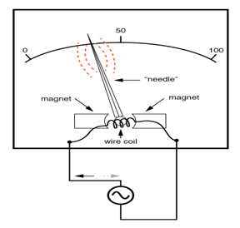
IN SIDE VIEW OF AN AMMETER
z

Slide 4

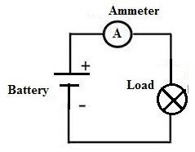
SYMBOL OF AMMETER USED IN THE CIRCUIT DIAGRAMS IS SHOWN IN THE DIAGRAM.
z

Slide 5
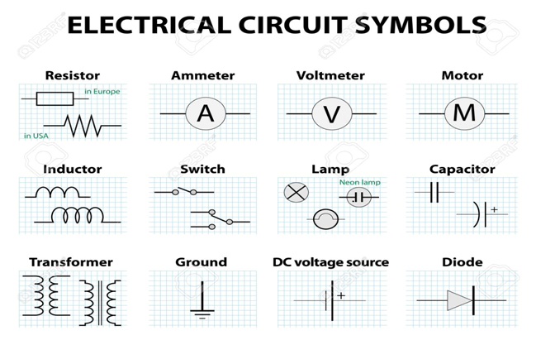
SOME COMENLEY USED CIRCUIT SYMBOLS.

Slide 6
Principle of Ammeter
The principle of ammeter is that the resistance and inductive reactance must be very low. Ammeter has a very low impedance as the voltage drop across the ammeter should be low. The ammeter cannot be connected in parallel because of the above-mentioned reason. In a series connection, the current will be same. Also connecting an ammeter in parallel may result in short circuit and the current passing through ammeter might burn the instrument. For an ideal ammeter, the impedance must be zero so that the voltage drop across the instrument is zero.

Slide 7
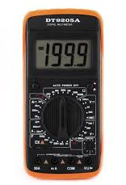
How does an ammeter measure DC current?
To measure current, you must connect the two leads of the ammeter in the circuit so that the current flows through the ammeter. In other words, the ammeter must become a part of the circuit itself. The only way to measure the current flowing through a simple circuit is to insert your ammeter into the circuit.

Slide 8
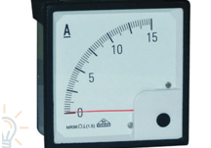
UNIT
an Ammeter is an instrument used for measuring electrical current (I) and gets its name from the fact that the unit of measurement is “amps”, or more precise, Amperes.

Slide 9
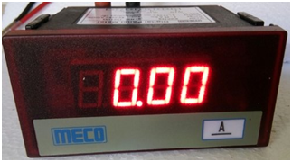
Application
There are a wide range of application, given below are some of them;
Industrial control and monitoring of machines- used by operators to check how much current is drawn by machines and decide on regulation.
Power generation, transmission, and distribution firms- to determine the quantity of electricity generated or supplied. This is done along with a voltmeter and energy meter.
Technicians when servicing equipment.

Slide 10
Types of An Ammeter
The two broad categories are direct current and alternating current types. This owes to the fact that current is a directional parameter. The subcategories include;
Moving coil – it has a permanent magnet around the coil as a source of the magnetic field and measures dc current only.
Moving iron – it has soft iron as an electromagnet when current flow the induced magnetism reacts with induced magnetism of the coil to deflection of the pointer. It can measure both ac and dc current.
Electrodynamic– this is a dynamic one as it can measure both ac and dc without the need to calibrate the meter.
Rectifier– this a permanent magnet type with an additional rectifier to convert ac to dc hence allowing it to be measurable.

Slide 11
THANK YOU

Slide 12
